Slide 1






DMDD GROUP 17 PRESENTS -
E-LEARNING
DATABASE MANAGEMENT SYSTEM
SIDDHANT
FORAM
YAGNIK
VIGNESH

Slide 2

INTRODUCTION
In today’s digital age, e-learning has become essential for education. Our focus will explore the strategies involved in managing an effective e-learning platform, emphasizing optimized student engagement and learning outcomes. Central to this discussion is our crafted E-Learning Platform Management System—a technological innovation aimed at breaking financial barriers and providing a seamless pathway to quality education.

Slide 3

To empower continuous learning and enhance educational accessibility, our mission is to lead the way with an E-Learning Platform Management System. Dedicated to breaking financial barriers, fostering collaboration, and offering transparent learning paths, our innovative reward points inspire personalized learning and real-time progress tracking for career growth. We aim to create an inclusive, affordable, and dynamic educational environment.
MISSION STATEMENT

Slide 4

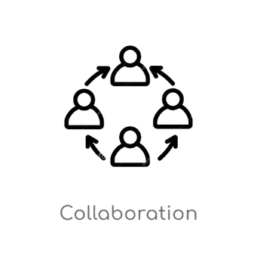

Database Implementation for Education Management
KEY OBJECTIVES
Develop an integrated and efficient database for managing student records, course details, educational institutions, and related data.
Transparent Course Points Tracking System
Create a transparent database system to track and utilize students' earned course points effectively.
Comprehensive Course Completion Rewards Program
Establish a comprehensive rewards system for course completion, fostering learner motivation through recognition and continual support in achieving certificates.
Community Cultivation for Collaborative Learning
Cultivate a collaborative student community, encouraging idea exchange, peer-to-peer learning, and providing access to mentors and trainers for learner assistance.

Slide 5

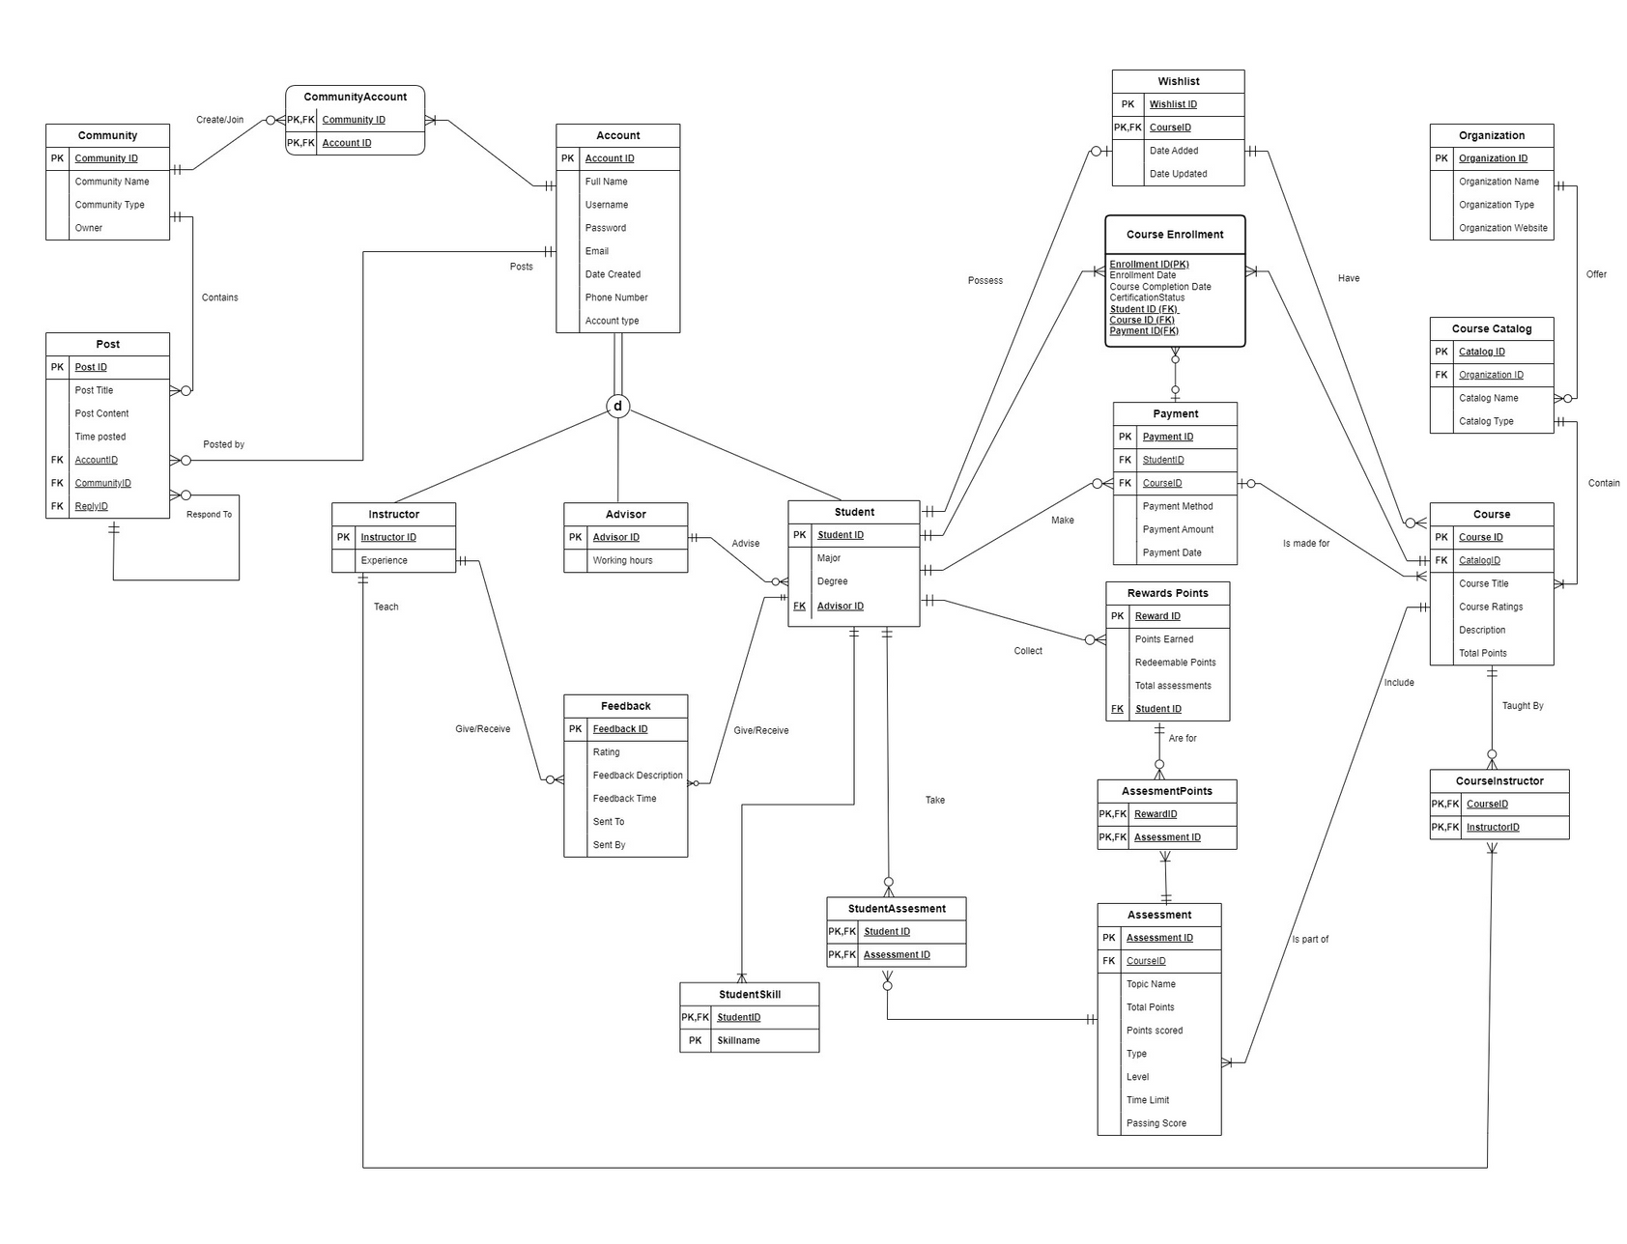
FINAL E-R DIAGRAM

Slide 6
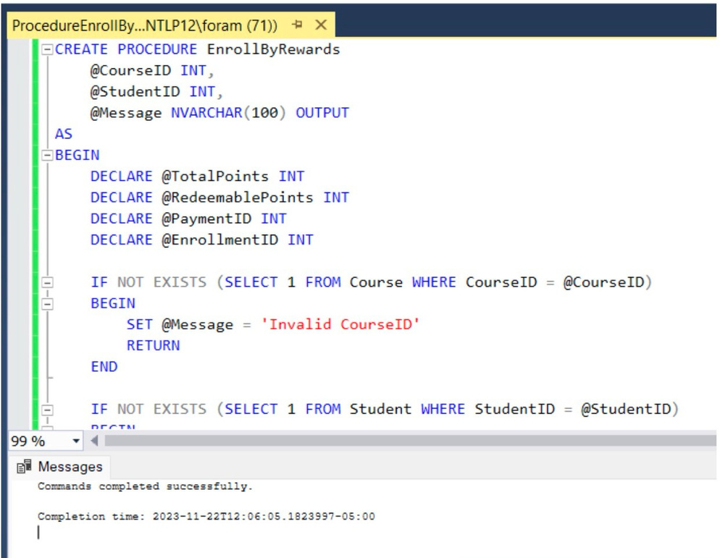
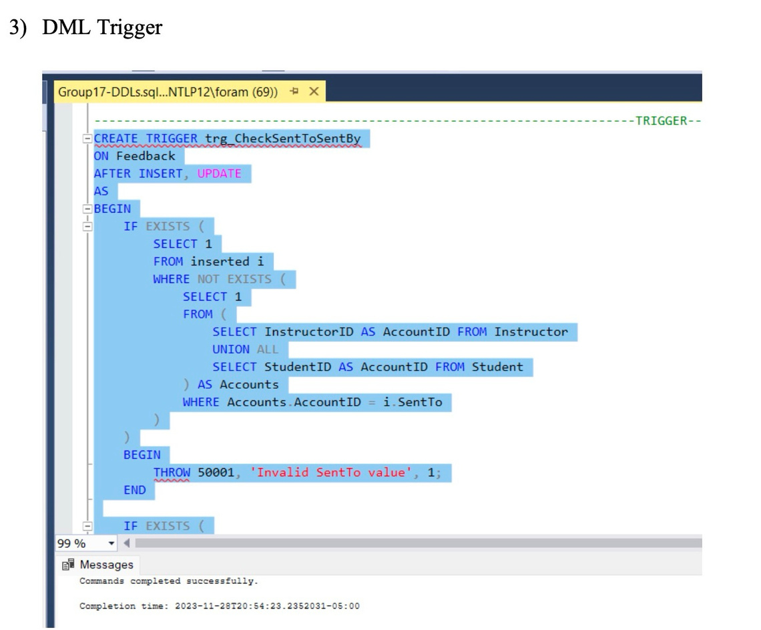
DDL STATEMENTS
STORED PROCEDURES
TRIGGER

Slide 7
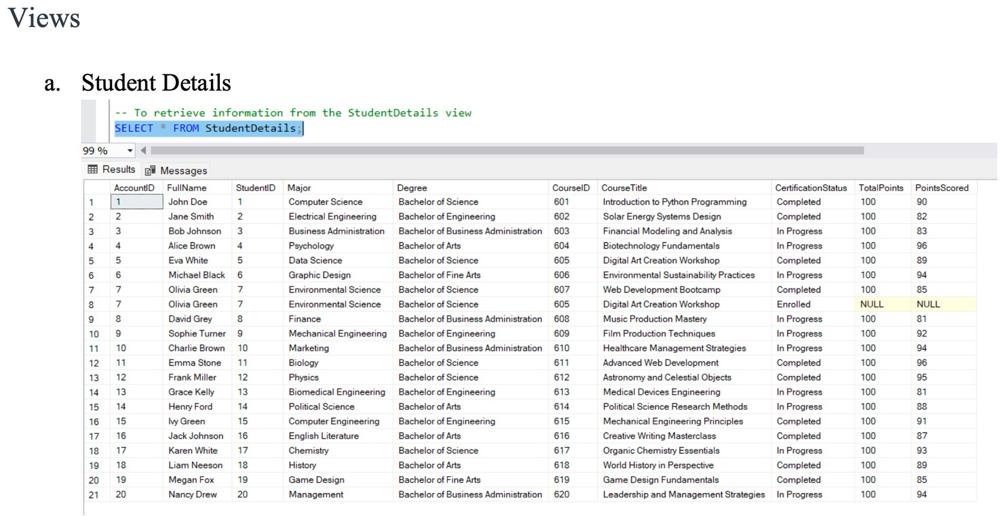
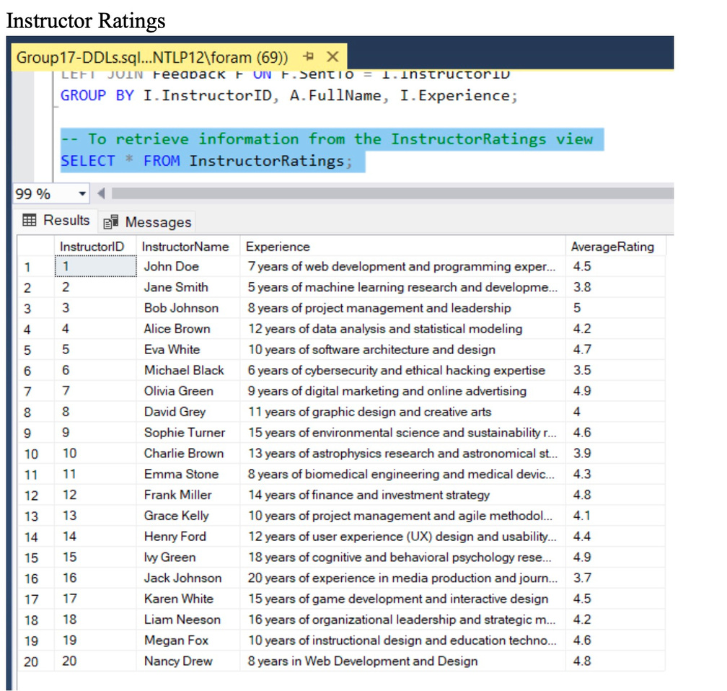
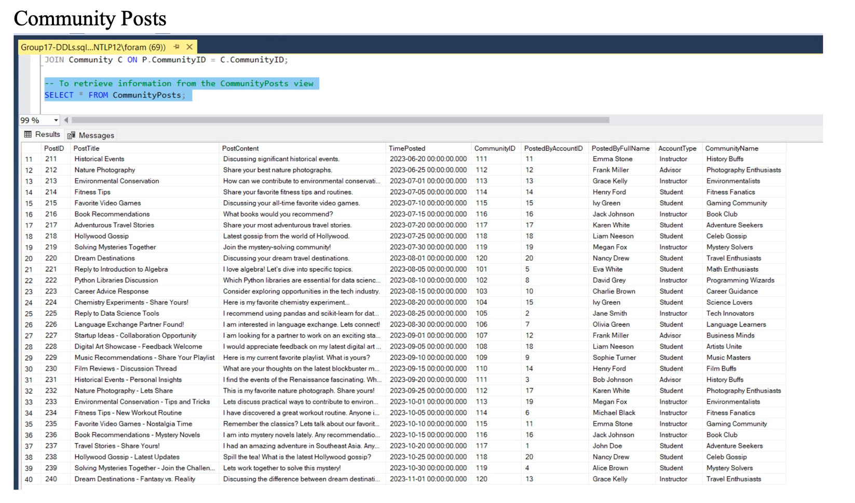
DDL STATEMENTS
VIEWS

Slide 8
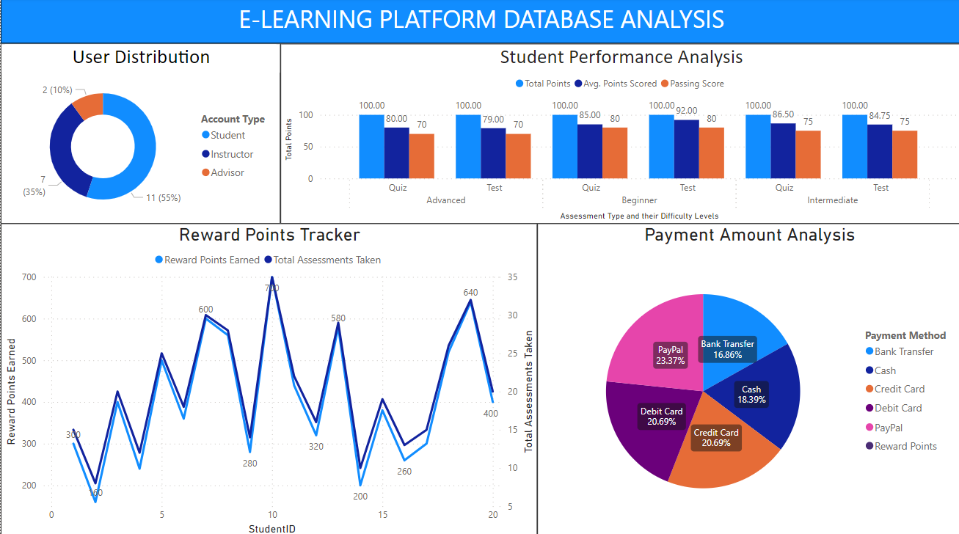
VISUALIZATION LAYER

Slide 9
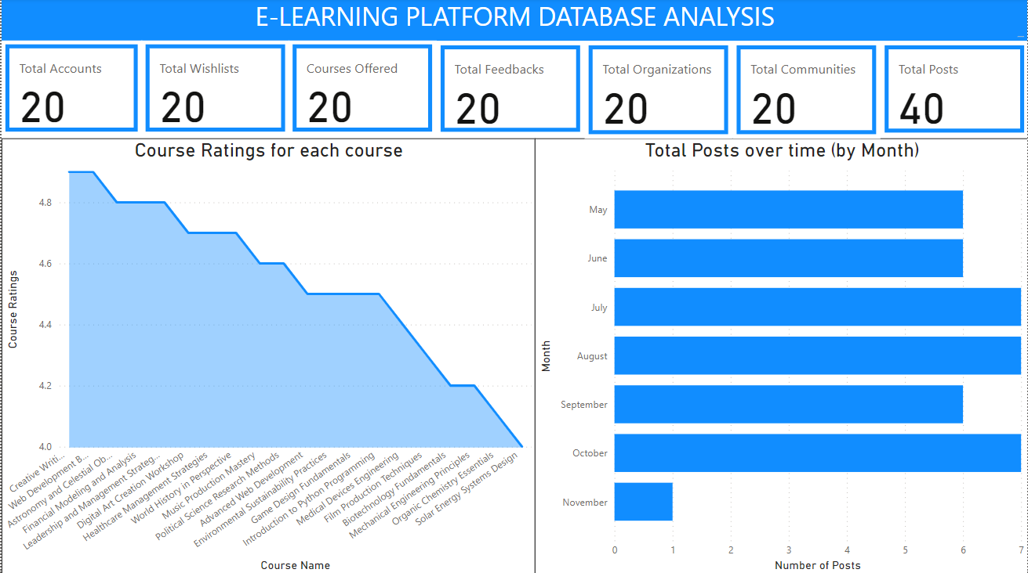
VISUALIZATION LAYER

Slide 10

THANK YOU

